Slide 1
Welcome to the Department of Sociology and Anthropology

Slide 2
Anthropology and Sociology at Swarthmore
Sociologists and anthropologists study the social structures and cultural systems that create order and meaning in human societies and cultures as well as the pressures and contradictions that produce patterns of conflict and change.
Our department provides a dual discipline with classes that are culturally relevant and address important issues such as race relations, health & illness, body & agency, cultural memory & nationalism, the environment & society, food & culture, work & organization, gender & sexuality, migration, cities & urban life, class inequalities, carceral policy, law & society, and civic participation. Students explore these themes in the classroom and through fieldwork and independent study.

Slide 3
Meet Our Anthropology Faculty

Slide 4
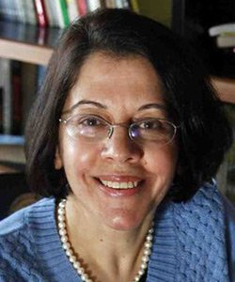
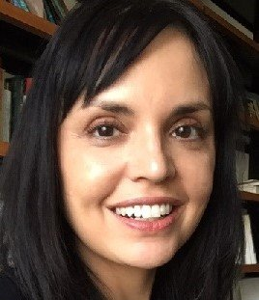
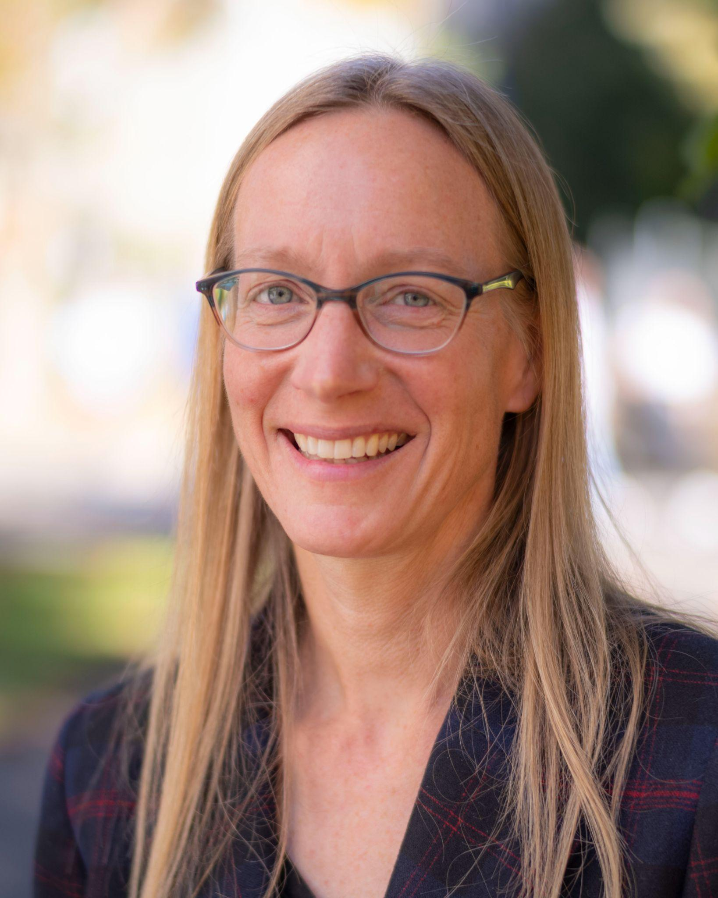
Farha Ghannam, Professor of Anthropology
Urban anthropology; gender inequalities; anthropology of the body; food and culture, anthropological theories; history of ethnography; Globalization/transnationalism; Middle East and North Africa, Egypt and Jordan. On sabbatical 2025-26
Maya Nadkarni, Associate Professor of Anthropology
Cultural memory and national identity; anthropology of postsocialism and Eastern Europe (Hungary); visuality, mass media, and visual anthropology; anthropology of gender and the family; anthropology of knowledge; genetics, temporality, and risk. On sabbatical 2027-28
--
Christy Schuetze, Associate Professor of Anthropology
Anthropology of Africa; anthropology of religion; medical anthropology; globalization; anthropology of development; health and society; Pentecostal-Charismatic Christianity; environmental anthropology; post-colonial economics and gender; state and traditional relations in governance. On sabbatical 2026-27

Slide 5
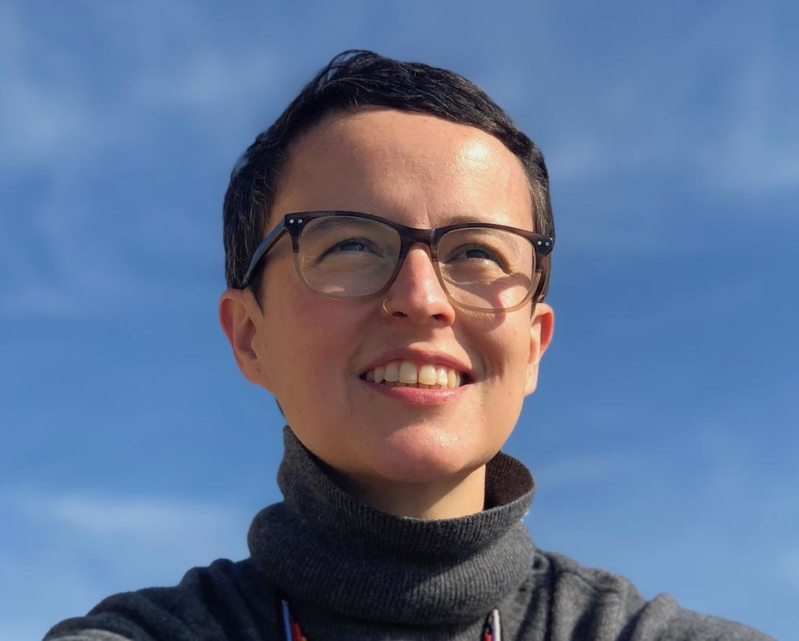
Alejandra Azuero-Quijano, Assistant Professor of Anthropology
Anthropology of law; theories of justice; liberalism; anthropology of finance; humanitarianism; digital ethnography; feminisms/feminist theory; anthropology of Latin America; Colombia.
On sabbatical 2024-25

Slide 6
Meet Our Sociology Faculty

Slide 7
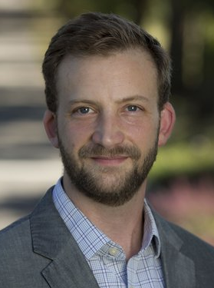
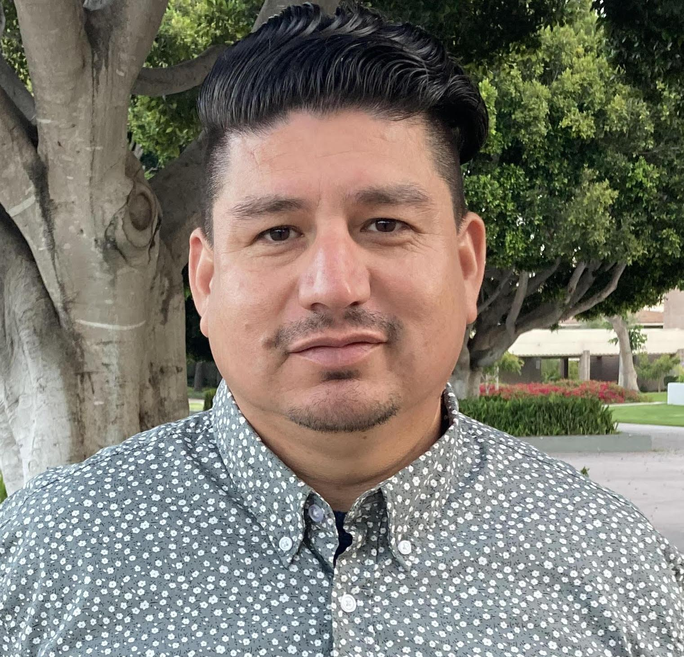
Nina Johnson, Associate Professor of Sociology and Black Studies
Politics; Culture; Race; Class Mobility; Inequality; Cities; Carceral Policy; Qualitative methods. On sabbatical 2026-27
Daniel Laurison, Associate Professor of Sociology
Politics; Political participation and engagement; Class/Inequality/Stratification/Mobility; Quantitative methods. On sabbatical 2028-29
Salvador Rangel, Assistant Professor of Sociology
Class; Race; Migration and illegality; Citizenship, Inequality; Marxism and socialism; Social psychology. On sabbatical 2027-28

Slide 8
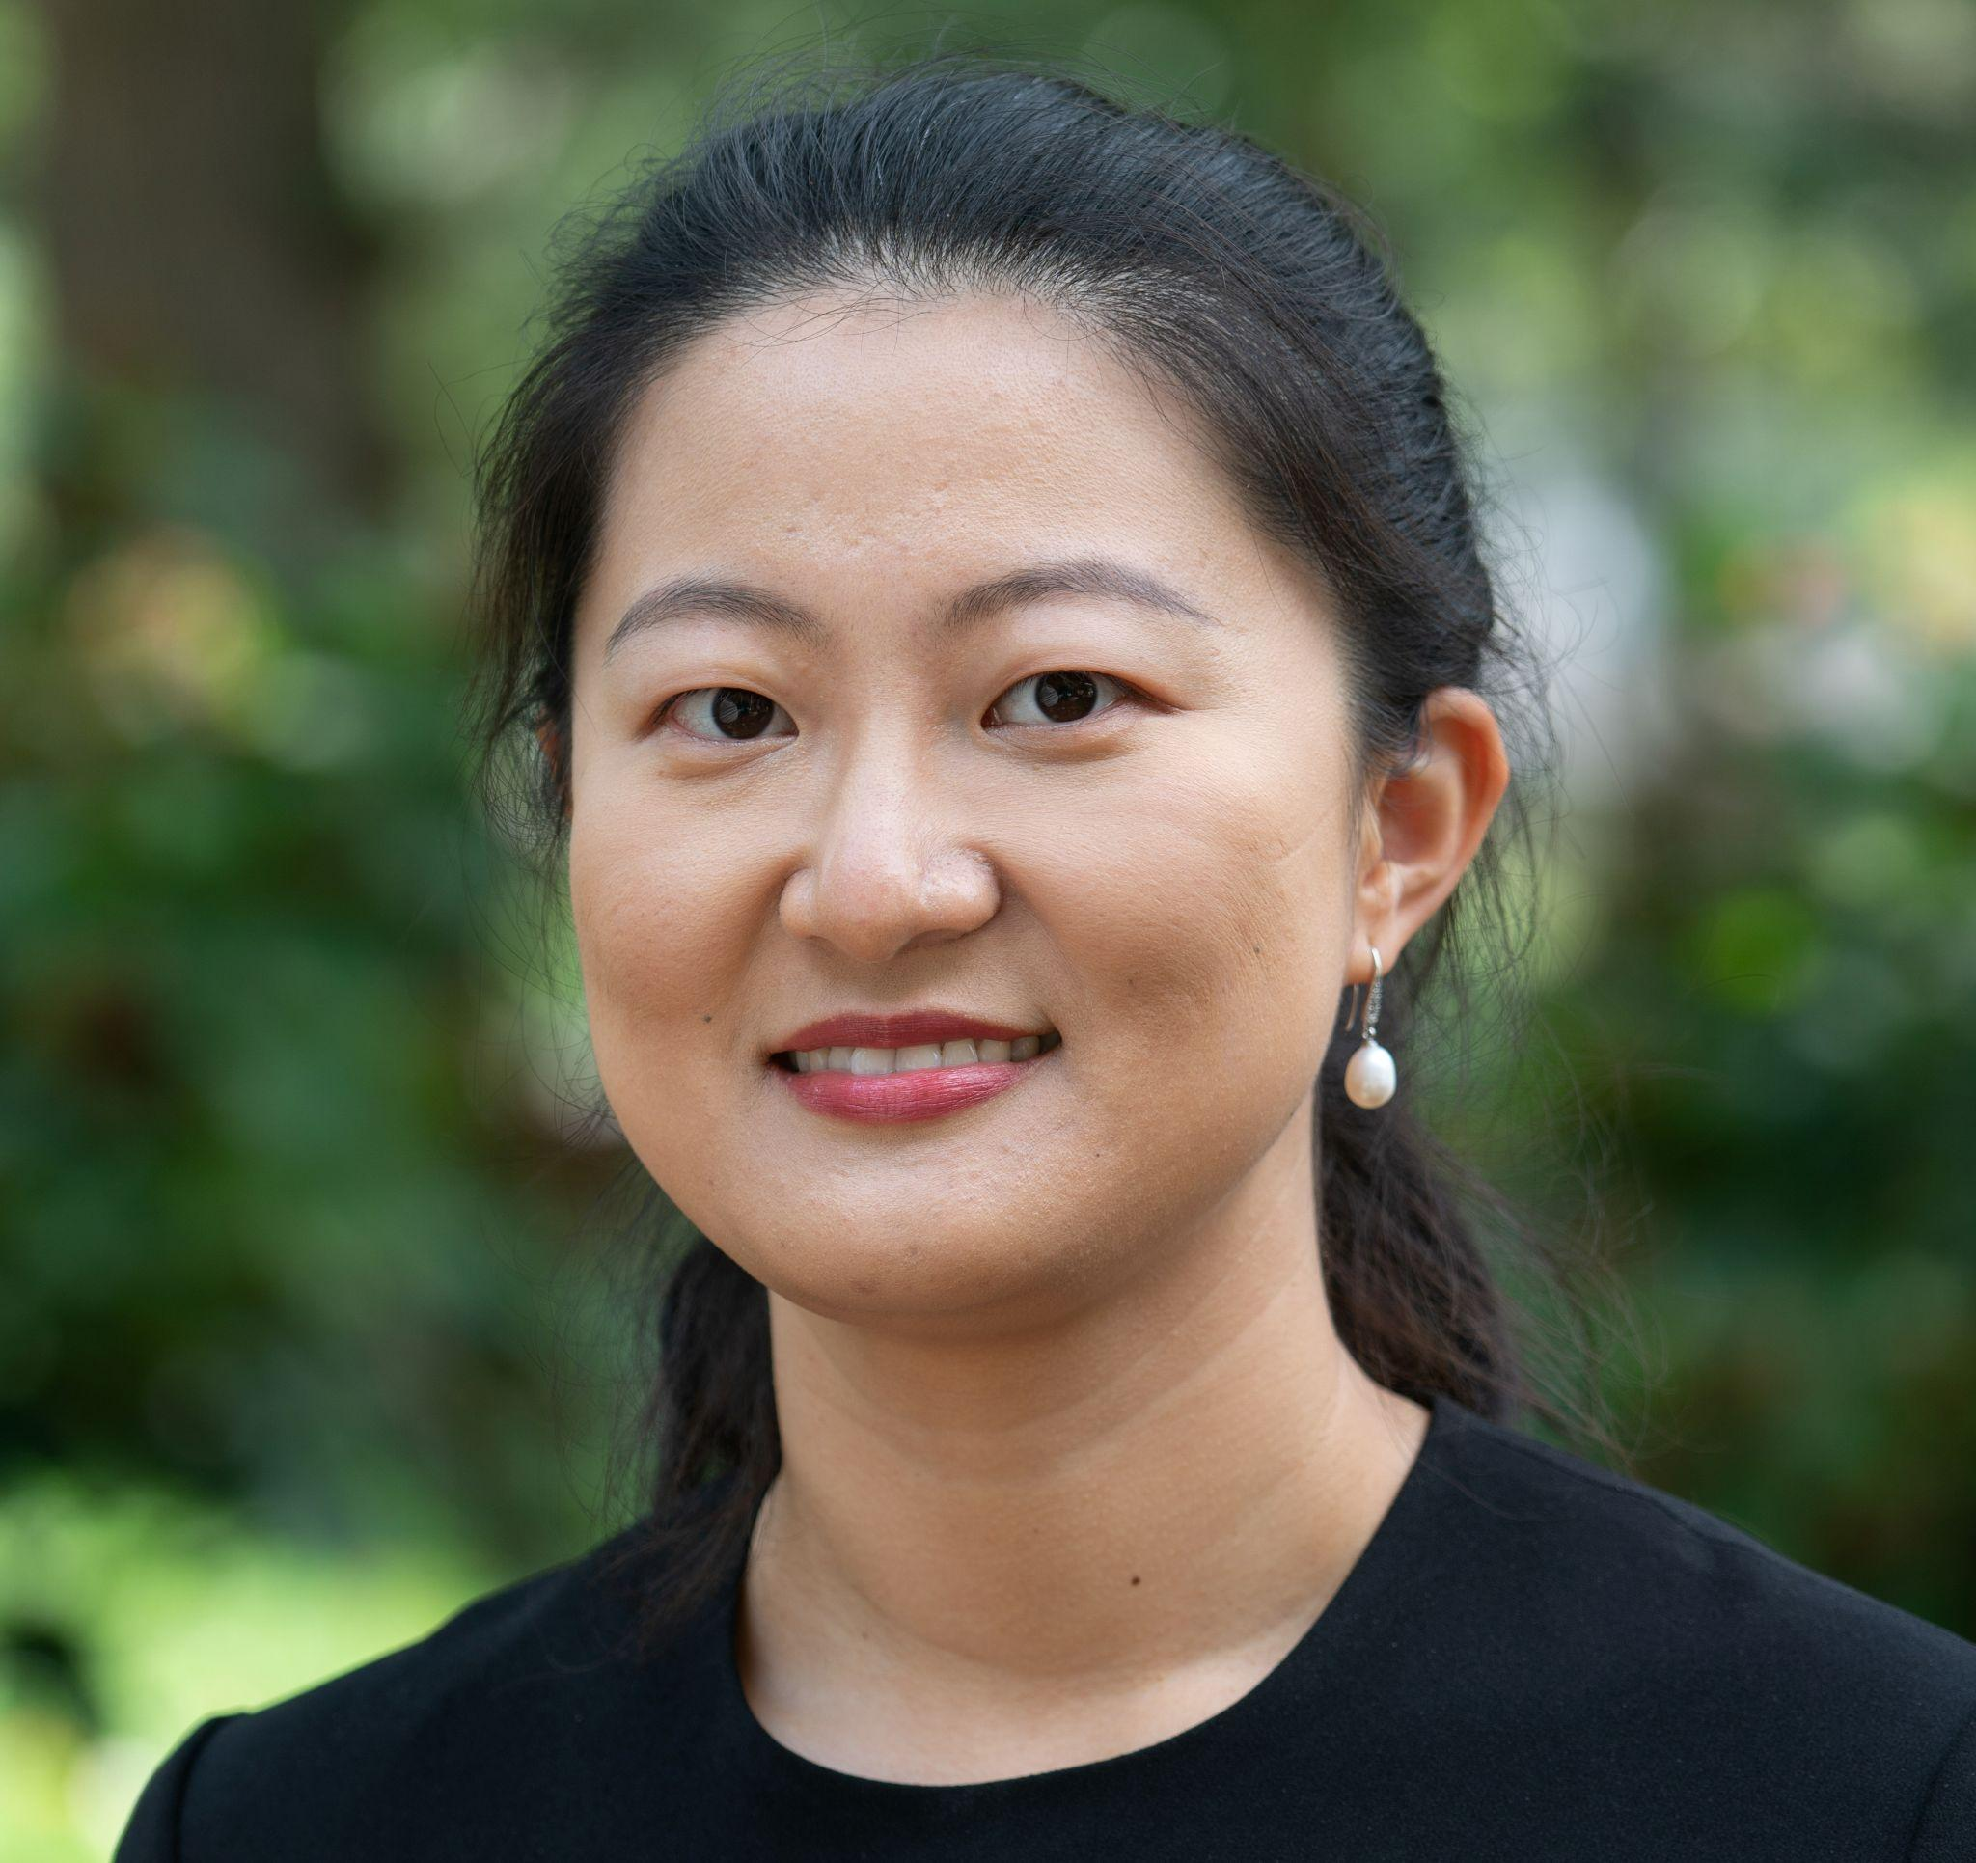
Edlin Veras, Assistant Professor of Sociology and Black Studies Racialization Processes; Colorism; Immigration; Colonialism; Qualitative Methods. On sabbatical 2027-28
Suya, Visiting Assistant Professor of Sociology Marriage and Family, Gender and Sexuality; Research Methods and Social Statistics, Law and Society, China and East Asia

Slide 9
Core (required) Courses for Majors
ANTH 001. Foundations: Culture, Power, and Meaning
SOCI 001. Foundations: Self, Culture, and Society
At least one designated Methods course in the dept
A 2-credit senior research project (SOAN 098, SOAN 096/097 or SOAN 180F/180S)
Senior Research Project Master Class (SOAN 098)

Slide 10
Departmental Credit Requirements
Course Major: at least 8 credits; Core Courses + 3 add’l courses in the dept
Course Minor: Not offered
Special Major: at least 10 credits; Core Courses + at least one add’l credit in SOAN and up to four credits outside of the dept
Major Concentration in Medical Anthropology: at least 10 credits; Core Courses + either ANTH 043E or ANTH 049B + four elective credits (at least two additional courses in SOAN and up to two courses outside the department in the thematic area). Students should consult with their advisor when selecting courses.
Major Concentration in Political Sociology: at least 10 credits; Core Courses + five elective credits (at least three additional courses in SOAN and up to two courses outside the department in the thematic area). Students should consult with their advisor when selecting courses.
Major Concentration in Urban Studies: at least 10 credits; Core Courses + five elective credits (at least three additional courses in SOAN and up to two courses outside the department in the thematic area). Students should consult with their advisor when selecting courses.

Slide 11
Honors Major: Core Courses (thesis will be used as a preparation) + Two additional 2-credit preparations in dept
Honors Minor: ANTH 001, SOCI 001, at least one designated Methods course will include one 2-credit preparation in the dept
Honors Special Major: Core Courses (thesis will be used as a preparation) + Three 2-credit preparations

Slide 12
Senior Research Project
Our majors conduct original research and will present passionately about significant and timely issues.
Recent topics include: Doula Work and Black Maternal Health; Colorism and Ideals of Beauty; Class Identity and Political Participation; Chronic Pain and Social Media; Food and Identity; Health Care and the Legal System; and Queer Spaces and Identities.
Please visit the thesis posters displayed in our department on Kohlberg’s second floor.
Archived theses available to view in print in Kohlberg 236 and through the library

Slide 13
Major Concentration in Medical Anthropology
Offers students the opportunity to tailor a scholarly exploration of medicine, health, and illness with a foundation in anthropology. Medical anthropology is a dynamic subfield of the discipline that offers important theoretical, critical, and comparative perspectives to the study of medical systems and healing practices in different cultures, and it provides ways to shape the work and practices of medical institutions and professionals. Medical anthropology pays attention not only to biomedicine and scientific knowledge but also to diverse ways of healing, managing pain, and defining wellbeing. It also pays close attention to the different local, national, and global forces that shape the health and wellbeing of various groups and their access to resources and knowledges. This special major will be of particular interest to students interested in graduate work in medical anthropology, the study of medicine, and those planning on pursuing training and work in diverse professions of the health field.

Slide 14
Major Concentration in Political Sociology
Offers students an opportunity to ground their inquiries into all things political--political economy, forms of political order and organization, regime formation and revolution, political action, parties and elections, policy, status, power--in a sociological approach that seeks to interrogate and understand social structures and insists that politics must be treated as fully implicated in every facet of the social order, from institutional arrangements to social relations. Political Sociology encompasses a wide variety of theoretical and methodological approaches with which sociologists attempt to describe and explain political phenomena. We cover a wide range of areas within the field, including race, class, migration, colonization, imperialism, public policy, urban politics, social movements, state-formation, revolutions, and cross-national social policy and policy outcomes.

Slide 15
Major Concentration in Urban Studies
Offers students the opportunity to explore the city, its social, economic, political, and cultural life. Urban Studies is an interdisciplinary academic field that examines the social, economic, political, and environmental aspects of cities, exploring issues like urban development, housing, infrastructure, poverty, inequality, organizing and resistance movements, arts, architecture, and environmental sustainability, aiming to understand how cities function and develop solutions to urban challenges through a combination of theoretical knowledge and practical application, including the incorporation of fieldwork and community engagement within local urban environments. Historically, sociology and anthropology have actively worked to understand the inequalities that structure and that are structured by urban life. Appreciating the complex nature of the city and the different meanings of the urban, this concentration provides students with solid grounding in sociology and anthropology while at the same time providing them with the space to draw on other disciplines to further their understanding of the city, its past, present, and future and explore specific topics (such as space, place, gentrification, public policy, the carceral state, policing, consumption, education, migration, and mobility).

Slide 16
A B.A. in Sociology and Anthropology...
Prepares for future graduate work in anthropology, business, communications, design, education, ethnic and gender studies, international studies, journalism, medicine, public health, research, and sociology
Offers valuable preparation entry level positions in business, colleges/universities, communications, counseling, education, government, health and human services, law, the media, medicine, museums, politics, research, fields that involve investigative skills and working with diverse groups
You will find sociologists and anthropologists addressing social and cultural consequences of natural disasters, equitable access to limited resources, human rights, research partnerships, assessing economic needs, evaluating policies, developing new educational programs, recording little-known community histories, providing health services, and other socially relevant activities.
For more info, visit www.asanet.org/about/sociology.cfm and www.americananthro.org/

Slide 17
Our alumni have gone on to become distinguished anthropologists and sociologists, successful lawyers, dedicated physicians, passionate teachers, and outstanding participants in many other fields.

Slide 18
Where to find us
Second Floor of Kohlberg, Office Kohlberg 232
Sociology and Anthropology Website: https://www.swarthmore.edu/sociology-anthropology
Sociology and Anthropology Projected Courses: https://www.swarthmore.edu/sociology-anthropology/current-courses
Sociology and Anthropology Catalog: https://catalog.swarthmore.edu/preview_program.php?catoid=7&poid=292
Sociology and Anthropology, All Courses: https://catalog.swarthmore.edu/preview_program.php?catoid=7&poid=292#anthropologycourses

